Slide 1




DROWSINESS DETECTOR
ONLINE MEETING APPS
01

Slide 2

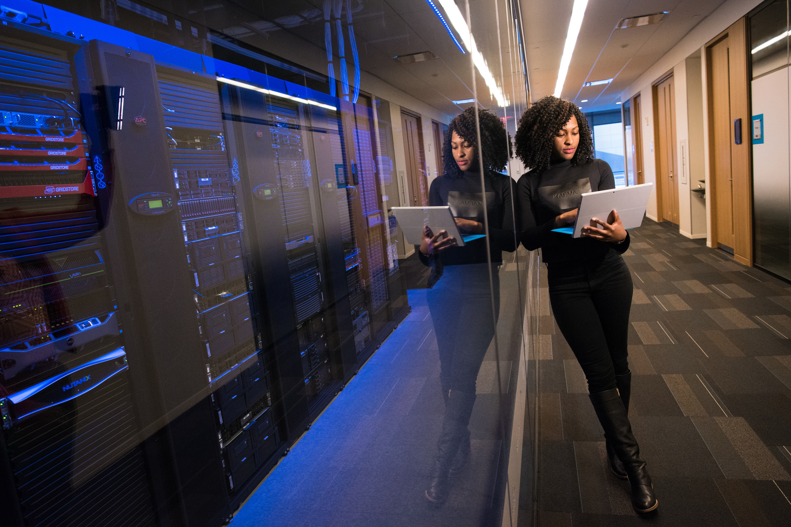
Drowsiness Detector
GROUP MEMBERS
1. Vivek Kumar Ahirwar
Sch No :- 191112419
2. Ayush Patel
Sch No :- 191112253
3. Parthesh Gupta
Sch No :- 191112231
02
ONLINE MEETING APPS

Slide 3
System Requirement
COLLEGE
Recommended System Requirements
Processors :ntel® Core™ i5 processor
RAM Required: 4 GB
Disk space: 2 to 3 GB
Operating systems: Windows® 10, macOS*, and Linux*
Working webcam
Minimum System Requirements
Processors: Intel® Core™ i3 processor
RAM Required: 2 GB
Disk space: 1 GB
Operating systems: Windows 10 Working webcam
ONLINE MEETING APPS

Slide 4

Software Dependencies:
ONLINE MEETING APPS
Main:
Python 3.6.0
PyCharm
Optional :
Microsoft Teams
ZOOM
Google Meet
04

Slide 5

Opencv-python
dlib
scipy
Library Used:-
playsound
os
05
ONLINE MEETING APPS
time
Library Used

Slide 6
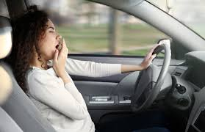
ISSUE 1:
A 2014 AAA Traffic Safety Foundation study found that 37 percent of drivers report having fallen asleep behind the wheel at some point in their lives. An estimated 21 percent of fatal crashes, 13 percent of crashes resulting in severe injury and 6 percent of all crashes, involve a drowsy driver.
ONLINE MEETING APPS
06

Slide 7
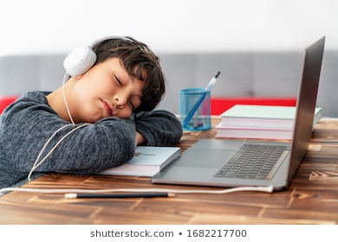
ISSUE 2:
Students now a days are attending online classes and while attending lots of time they go to sleep. Teacher will not able to know that a particular student is sleeping or not.
ONLINE MEETING APPS
07

Slide 8
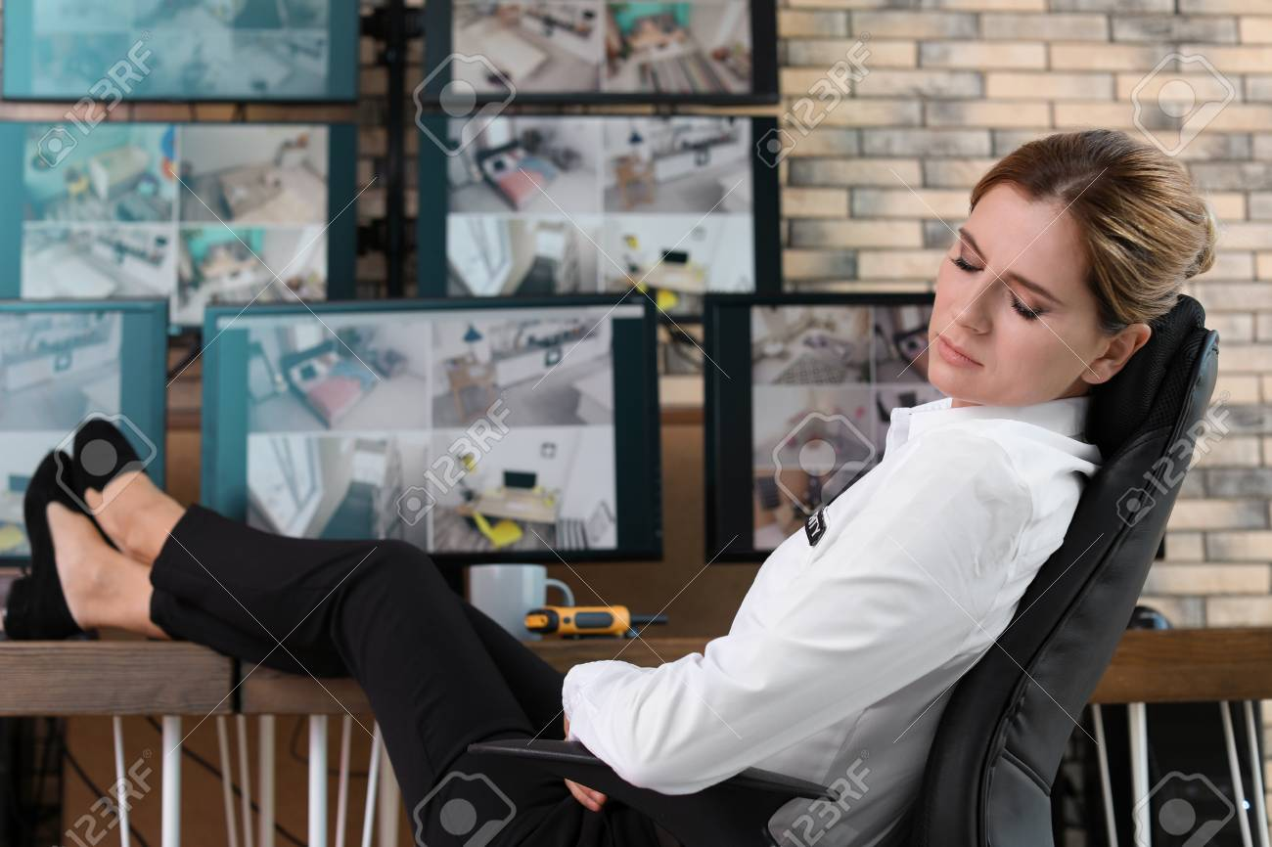
ISSUE 3:
SLEEPING ISSUES:
1.Office Employees
2.Security Guard
ONLINE MEETING APPS
08

Slide 9
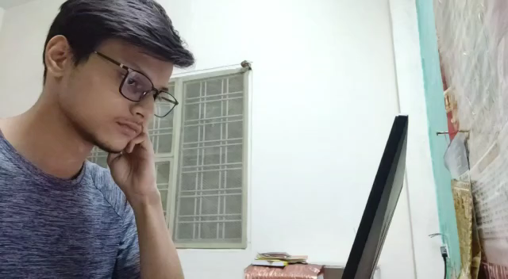
Demo reel
Presentations are communication tools that can be used as lectures.
09

Slide 10
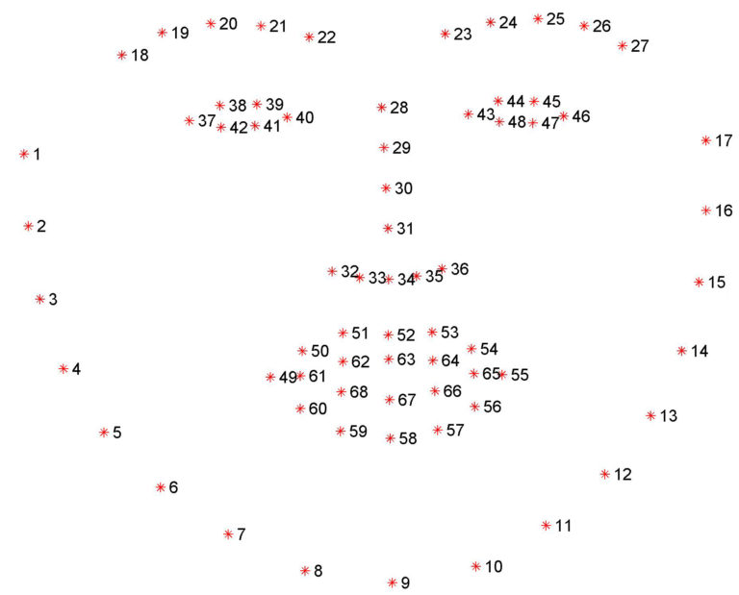

FACE LANDMARK
ONLINE MEETING APPS
10

Slide 11
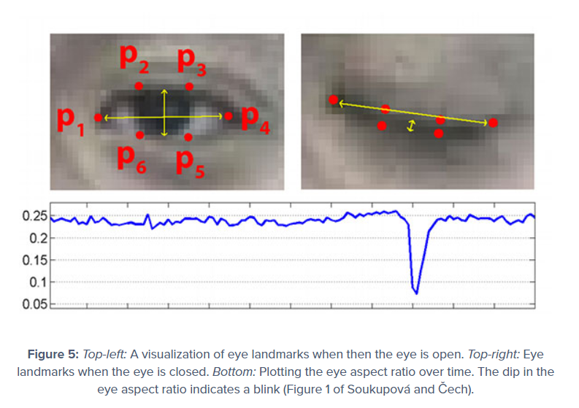
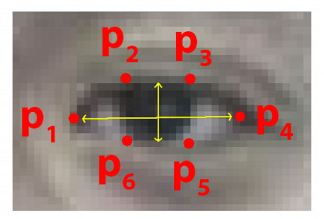
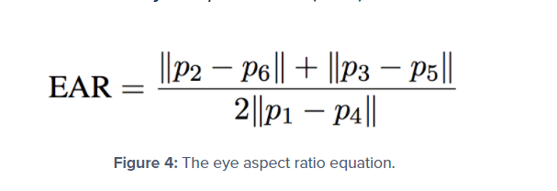
EAR
ONLINE MEETING APPS
10

Slide 12
Recommendations
ONLINE MEETING APPS
10

Slide 13



EMAIL
ahirwarvivek19@gmail.com
payush890@gmail.com
parthesh.motorwala@gmail.com
Let's work together
MOBILE
769490010
9009503831
9893833975
11
ONLINE MEETING APPS

Slide 14
Thank You
ONLINE MEETING APPS
12

